Slide 1
Musician booking app for wedding
Jaroslava Otman

Slide 2
Project overview
The product:
App to book a musician for the wedding. Many options to filter, for instance by date, genre, style, price. Verified live recording of the musician. Channel to communication between user and the musician.
Preview of selected polished designs.
Project duration:
June 2021 -

Slide 3
Project overview
The problem:
People struggle with finding the right band for they wedding day. The process of searching is very time consuming and could be chaotic.
The goal:
Key point is to save the time for the user and to let the user to have everything around the musician at one place.

Slide 4
Project overview
My role:
UX researcher,
Responsibilities:
User research,

Slide 5
User research
Personas
Problem statements
User journey maps
Understanding
the user

Slide 6
User research: summary
Firstly I did interviews with users. Based on the interviews I extracted the basic needs of the user when searching for the musician to book. This showed more insights than were assumed at the beginning of the research. Such as variety of the time needed for the bookdate (last call booking).

Slide 7
User research: pain points
1
2
3
4
Good live sound
Communication
Time
Genre
It is very important for users to actually hear the music of the musician alive. The need a verification of the recordings.
Users struggle with lots of places for communication. They want it to be in one place to have it organized.
Users do not have lots of time to spend with searching for the musician. They want it to be as quickly as possible.
There are many genre and styles of the musicians so the filter of the musicians is the very first key of the app.

Slide 8
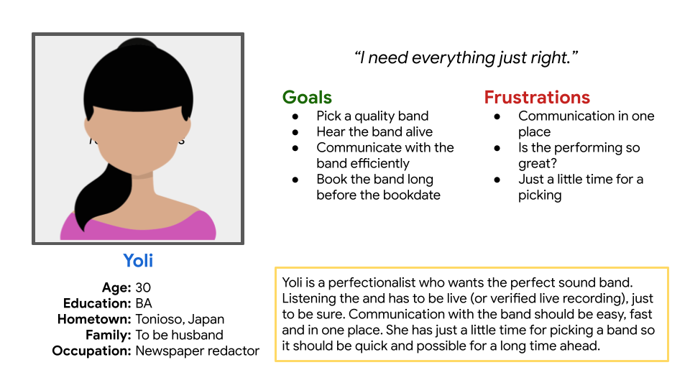
Persona: Yoli
Problem statement:
Yoli is a perfectionist newspaper redactor
who needs verification of the band
because she needs that perfect sound for her wedding.

Slide 9
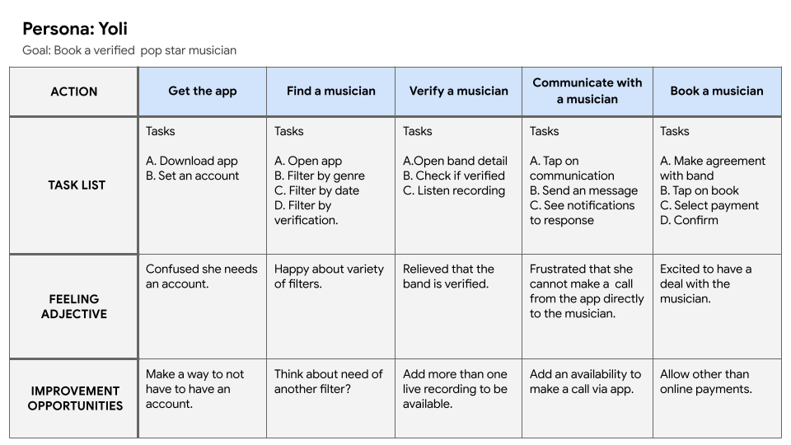
User journey map
This user journey map identifies primary and main journey the app will offer.

Slide 10
Paper wireframes
Digital wireframes
Low-fidelity prototype
Usability studies
Starting
the design

Slide 11
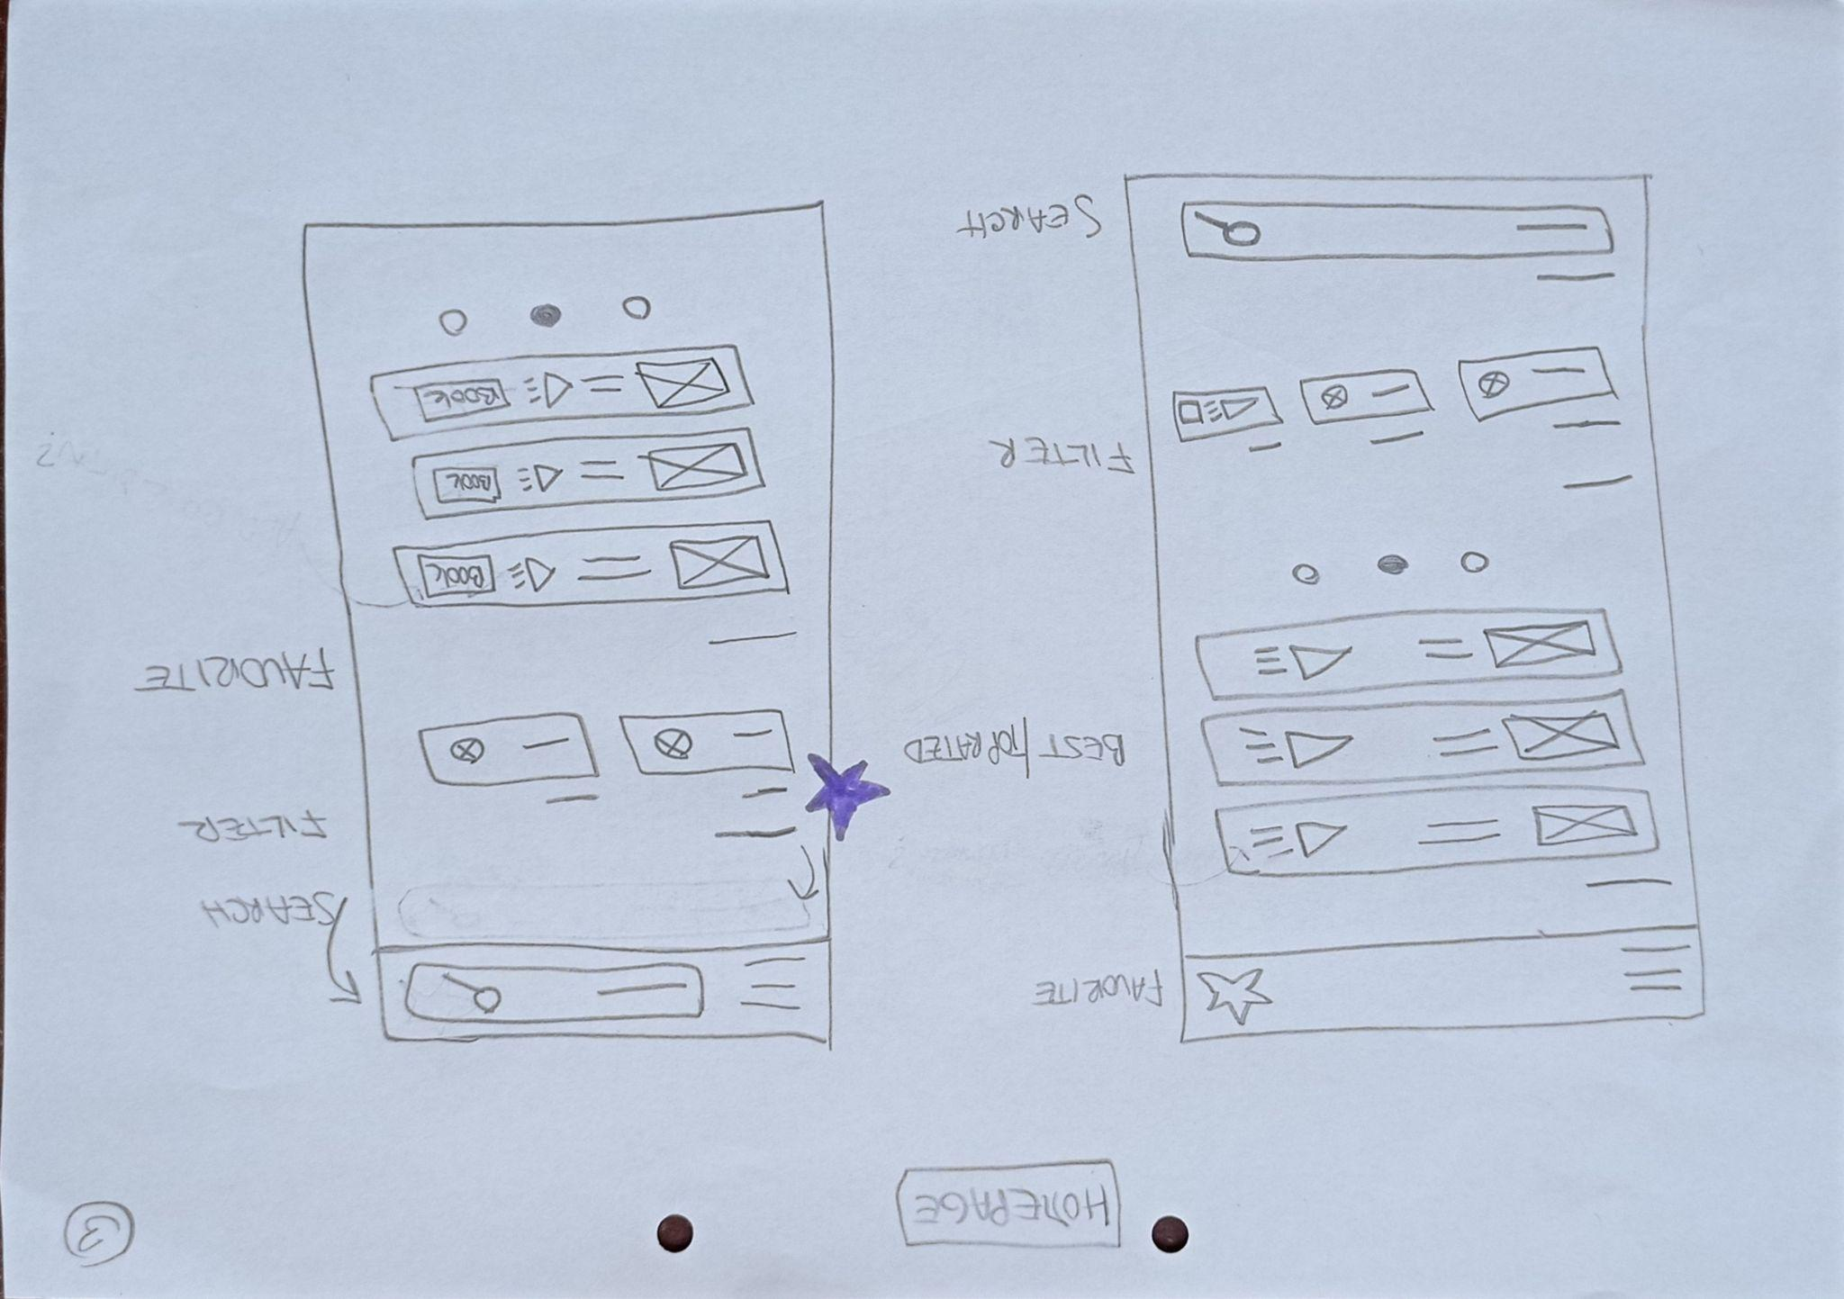
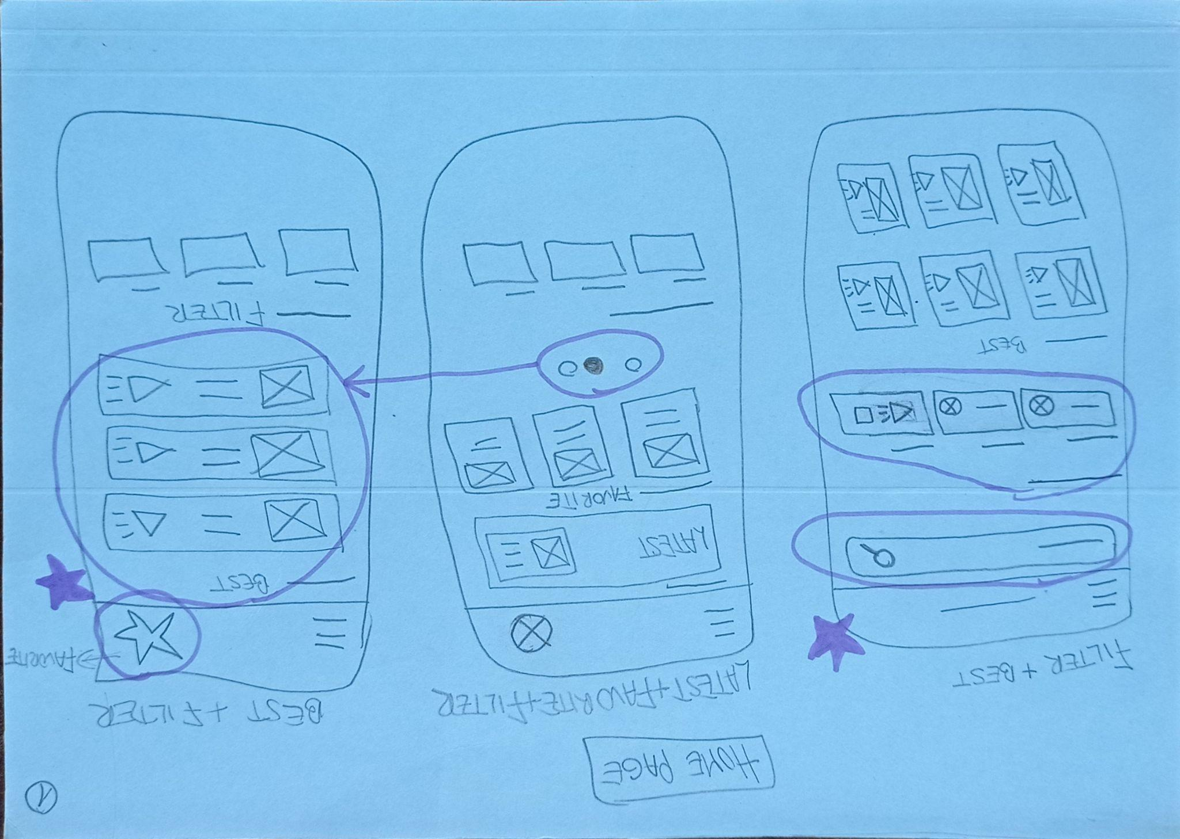
Paper wireframes
From five paper wireframes we collected favorited parts and pack it into one final wireframe.

Slide 12
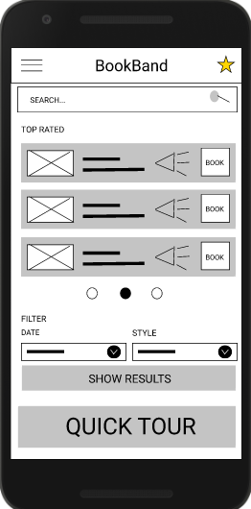
Digital wireframes
At the first view there is an option to listen the musician. Recordings are verification of the musician.
Home screen of the app should show user what the app is primary capable of. Here is obvious that every musician has a recording. Then there is a filter to shrink the amount of offered musicians.
Filter gives user an option to select when the musician is supposed to play and what kind of music the user wants.

Slide 13
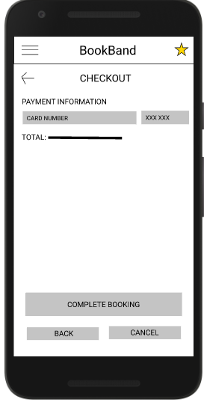
Digital wireframes
For quick and easy booking there is online payment by card.
Today everything is online, quick and easy. Payments are secured so why not to have the ability pay the musician right away. It is great for both parties.

Slide 14
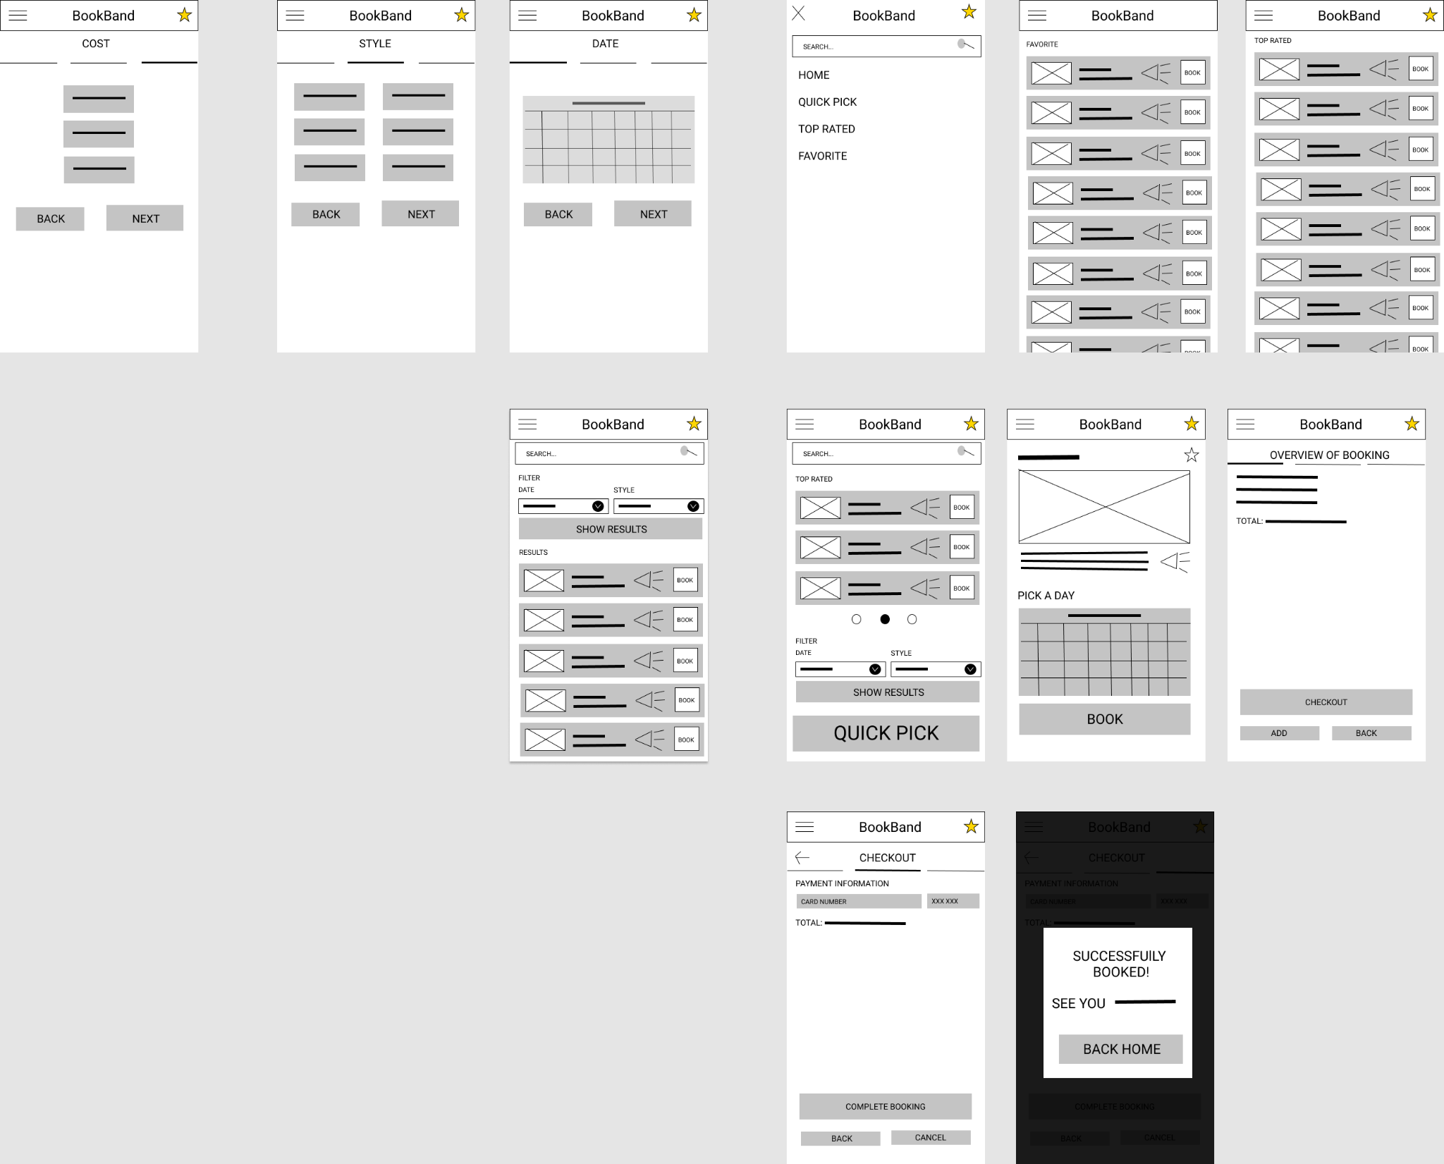
Low-fidelity prototype
Link to low-fidelity prototype:
https://www.figma.com/file/IqNAgGMTvuL9EtIZ4PGIgV/Booking-musician-for-wedding-venue-mobile-app?node-id=13%3A376
User starts at home screen. He can filter the musicians right away. The payment process is as short as possible
Screenshot of prototype with connections or prototype GIF

Slide 15
Usability study: findings
Study was conducted with 5 participants. Each of the user brought the new perspective on the app. Most spoken feedback were with the filter on the home screen and how can a user select a filtered musician to get to his detail page.
Round 1 findings
Round 2 findings
1
Placement of the filter
1
Top rated function not required
2
Selecting a musician
2
Searching option not required
3
Favorite star needs a label

Slide 16
Refining
the design
Mockups
High-fidelity prototype
Accessibility

Slide 17
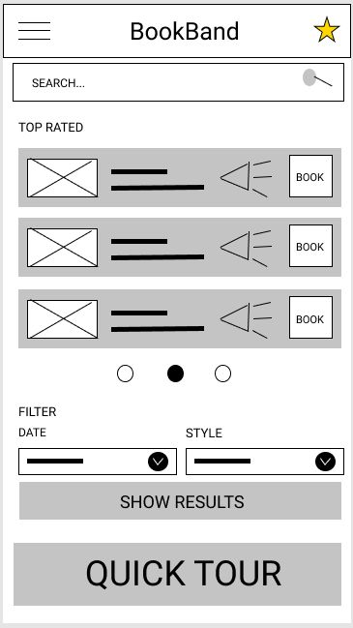
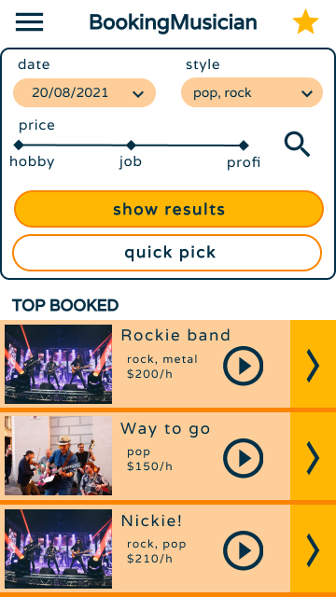
Mockups
Before usability study
After usability study
The biggest challenge was to reorganize the order of the element on the home screen. Users were confused where to start but after the new order of the elements, users were pointed right to the main task of the app.
Image of selected screen before usability study
Image of selected screen after usability study

Slide 18
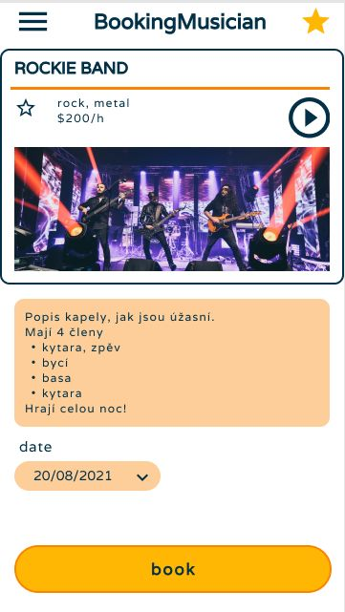
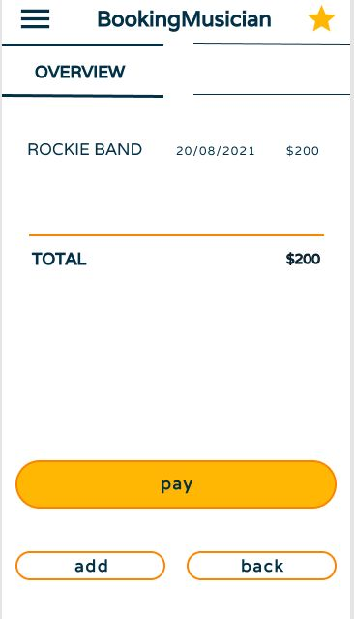
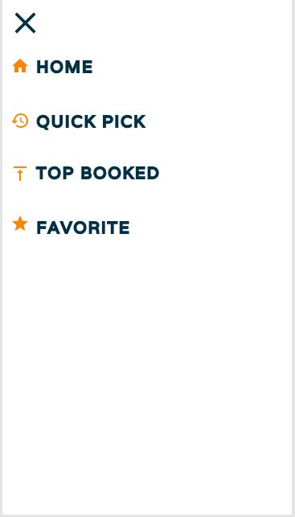
Mockups
Main mockup screen for display
Main mockup screen for display
Main mockup screen for display
Main mockup screen for display

Slide 19
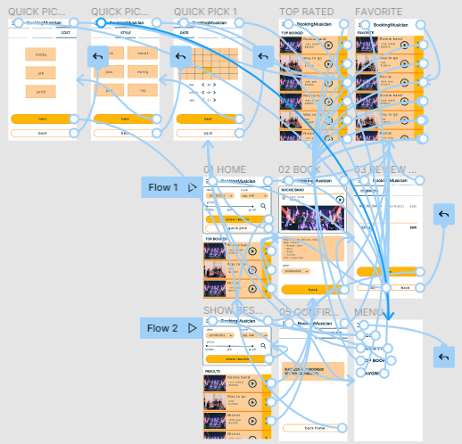
High-fidelity prototype
The final high-fidelity prototype presented cleaner user flows for booking a musician.
View the booking app
booking app
Screenshot of prototype with connections or prototype GIF

Slide 20
Accessibility considerations
1
2
3
Provided access to users who are vision impaired through adding alt text to images for screen readers.
Used icons to help make navigation easier.
Used images and sounds to better present the content.

Slide 21
Going forward
Takeaways
Next steps

Slide 22
Takeaways
Impact:
This app lets you listen to the recordings for free!
What I learned:
When creating the booking app I have learned that I constantly need to make changes based on the feedback and this process is endless. But at the end, the final product is awesome and sometimes way to far from the beginning.

Slide 23
Next steps
1
2
3
Conduct another round of usability studies to validate whether the pain points users experienced have been effectively addressed.
Conduct more user research to determine any new areas of need.
Gather feedback from the users.

Slide 24
Insert a few sentences summarizing the next steps you would take with this project and why. Feel free to organize next steps in a bullet point list.
Let’s connect!
Thank you for your time reviewing my work on the Booking musician app! If you’d like to see more or get in touch, my contact information is provided below.
Email: j.otmanova@gmail.com

Slide 25
Thank you!

